Slide 1
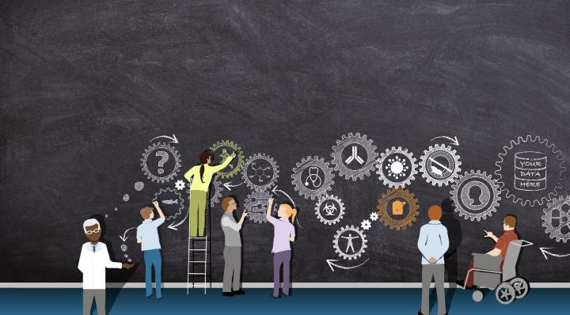


Personas: The concept of the translational workforce is an important one and plays a prominent role in the work and communication of CTSA Program hubs, NCATS, and beyond. However, to date, a defined list of translational workforce roles in CTS does not exist. Here, we aim to better define the specific roles included in the translational workforce, establish a set of personas to reflect those roles, construct a portfolio of these persona profiles, and disseminate broadly to the CTSA program and to the CD2H for use in development of use cases, communications, training materials, and more.
6 Jan 2019
Workgroup Name
Workgroup Name
CD2H SHow and Tell, Date
Notes:
Melissa

Slide 2
Benefits of CTS Personas
Personas help to focus decisions surrounding site components by adding a layer of real-world consideration to the conversation. They also offer a quick and inexpensive way to test and prioritize those features throughout the development process.
In addition they can help:
Stakeholders and leaders evaluate new resources, services, or events
Information architects develop informed wireframes, interface behaviors, labeling
Designers create the overall look and feel of an interface
System engineers/developers decide which approaches to take based on user behaviors and needs
Copy writers to ensure content and documentation are written to the appropriate audiences
The CTS community better understand the needs, challenges, and perspectives of a diverse translational workforce
The CTS community be more mindful and proactive of diversity and diverse perspectives.
What solution are you proposing? What is your project description?
adapted from https://www.usability.gov/how-to-and-tools/methods/personas.html
Notes:
Highlight the cloud, technology stack underneath (e.g., development story of leaf with hx
Why/what should be for everyone
Highlight what it will do: patients discovery across sites,

Slide 3
Personas Project Plan
1 | Establish Personas repo in https://github.com/data2health/ (saragon02)
2 | Contact Project partners and representatives from other institutions, set a regular meeting schedule
3 | Examine Personas project documentation and templates available at https://collectionsasdata.github.io/ and other resources. Upload current templates to GitHub
4 | First round of conversations: discuss the templates, what we like, what we might change to better suit the translational workforce; engagement opportunity
5 | Finalize CD2H Personas template
6 | Brainstorm/literature review/collection of job descriptions to identify the first batch of personas
7 | Begin to complete the Personas templates; schedule interviews as needed with representatives of different Personas
8 | Upload completed templates to GitHub, invite all team members to edit; hold additional meetings to discuss details and assess need for updates; engagement opportunity
9 | Develop exemplar use cases from the Personas to apply to different CD2H projects
10 | Engagement & dissemination
What solution are you proposing? What is your project description?
engagement
Notes:
Highlight the cloud, technology stack underneath (e.g., development story of leaf with hx
Why/what should be for everyone
Highlight what it will do: patients discovery across sites,

Slide 4
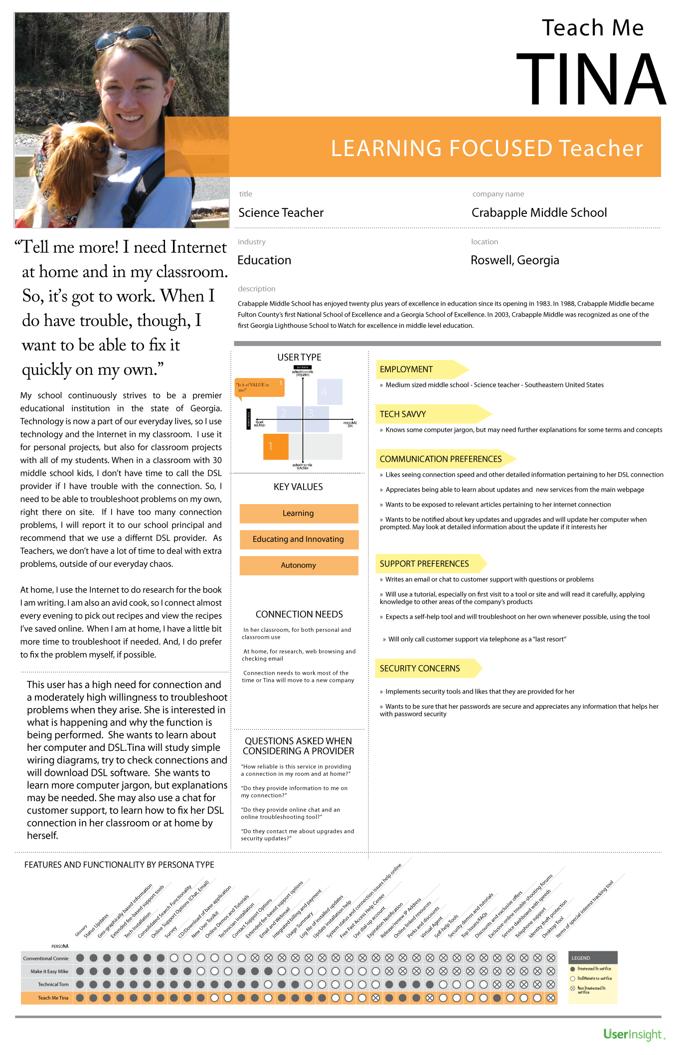
Some suggested persona elements
Persona Group (TBD)
Fictional name
Job titles and major responsibilities
Demographics such as age & education
The goals and tasks they are trying to complete
Their physical, social, and technological environments
Technological competence and needs
Casual pictures representing that user group
Software and data use and needs
Training background and needs
Drivers, goals, pain points
Quotes that sum up what matters most to the persona as it relates to CTS
What solution are you proposing? What is your project description?
https://www.usability.gov/how-to-and-tools/methods/personas.html
https://uxmag.com/articles/personas-the-foundation-of-a-great-user-experience
Notes:
Highlight the cloud, technology stack underneath (e.g., development story of leaf with hx
Why/what should be for everyone
Highlight what it will do: patients discovery across sites,

Slide 5
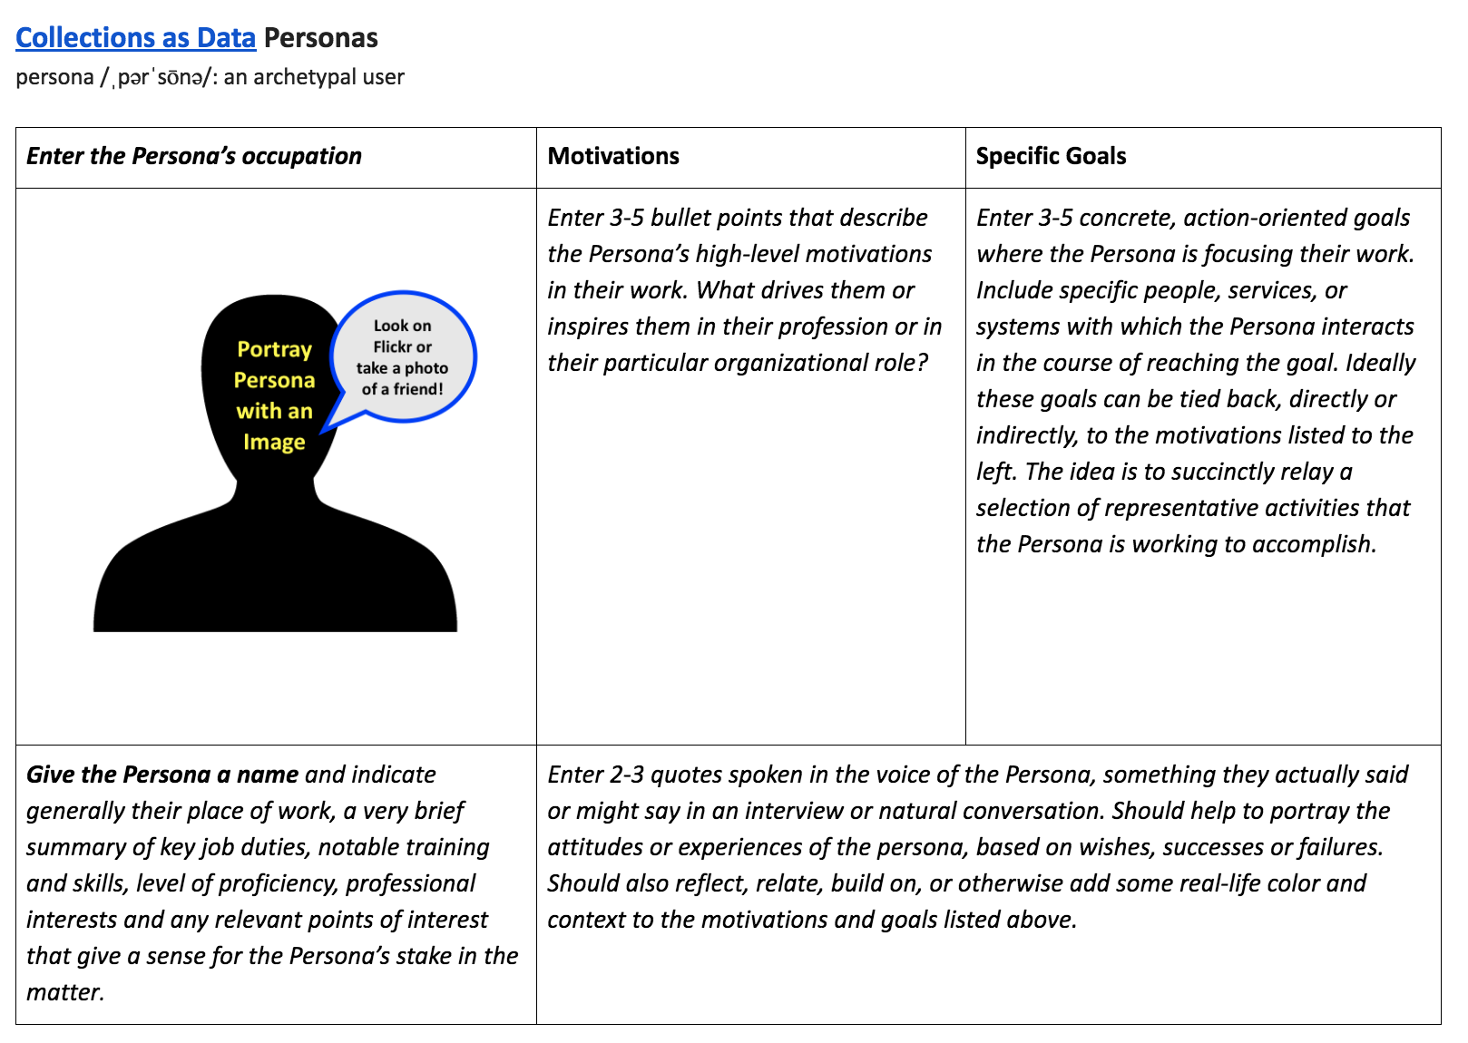
What solution are you proposing? What is your project description?
https://collectionsasdata.github.io/personas/
Notes:
Highlight the cloud, technology stack underneath (e.g., development story of leaf with hx
Why/what should be for everyone
Highlight what it will do: patients discovery across sites,

Slide 6
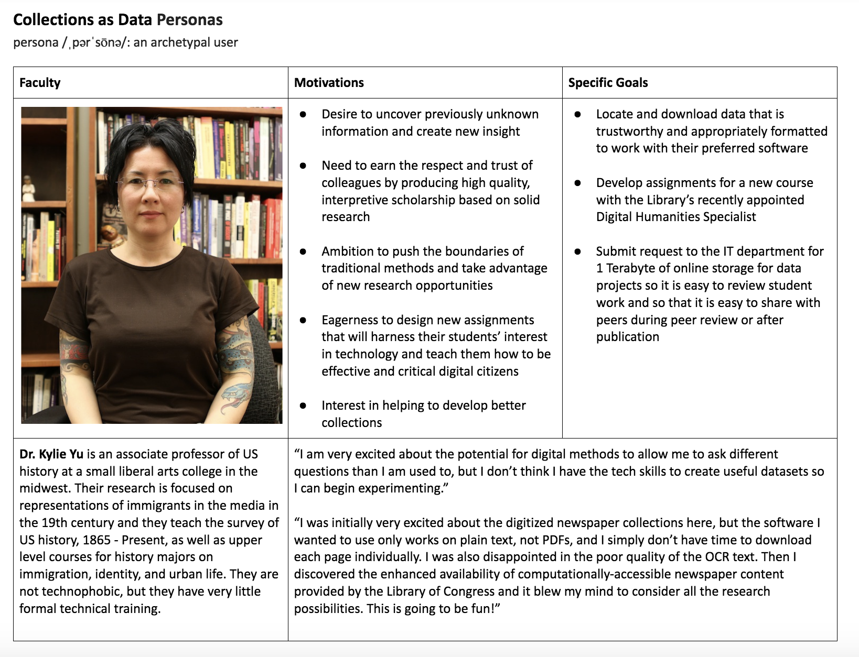
What solution are you proposing? What is your project description?
https://collectionsasdata.github.io/personas/
Notes:
Highlight the cloud, technology stack underneath (e.g., development story of leaf with hx
Why/what should be for everyone
Highlight what it will do: patients discovery across sites,

Slide 7
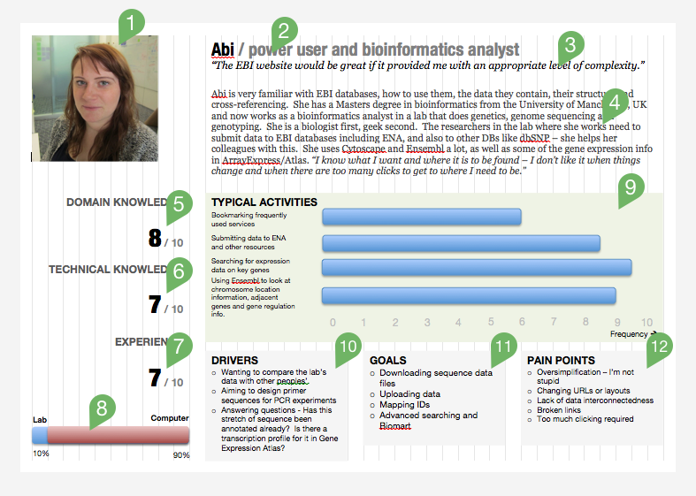
What solution are you proposing? What is your project description?
https://ebiinterfaces.wordpress.com/2011/12/01/personas-for-the-ebi-resdesign/
Notes:
Highlight the cloud, technology stack underneath (e.g., development story of leaf with hx
Why/what should be for everyone
Highlight what it will do: patients discovery across sites,

Slide 8
References & Examples
Contact Info
Sara Gonzales, project lead: sara.gonzales2@northwestern.edu Data Librarian @ Northwestern
What solution are you proposing? What is your project description?
https://www.usability.gov/how-to-and-tools/methods/personas.html
https://collectionsasdata.github.io/personas/ & https://drive.google.com/drive/folders/0B8ETyFnKCnQSNVRNeGpXMjl5bkk
http://uxmag.com/articles/personas-the-foundation-of-a-great-user-experience
https://venngage.com/blog/user-persona-examples/
https://www.givegoodux.com/creating-better-user-personas-tips-templates/
https://www.smashingmagazine.com/2014/08/a-closer-look-at-personas-part-2/
https://www.slideshare.net/TheConartist/provisional-persona-workshop-10
https://help.insight.com/app/answers/detail/a_id/195
https://ebiinterfaces.wordpress.com/2011/12/01/personas-for-the-ebi-resdesign/
http://www.uxforthemasses.com/personas/
https://ebiinterfaces.wordpress.com/2010/05/17/what-makes-a-good-persona/
https://www.eeoc.gov/eeoc/statistics/reports/hightech/
Notes:
Melissa
Highlight the cloud, technology stack underneath (e.g., development story of leaf with hx
Why/what should be for everyone
Highlight what it will do: patients discovery across sites,

